Slide 1
Backward Propagation
CSE451:Neural Network & Fuzzy Logic
MD Tamim Hossain
Lecturer
Department of Computer Science and Engineering
Premier University
“You cannot have a positive life and a negative mind.”
-Joyce Meyer

Slide 2
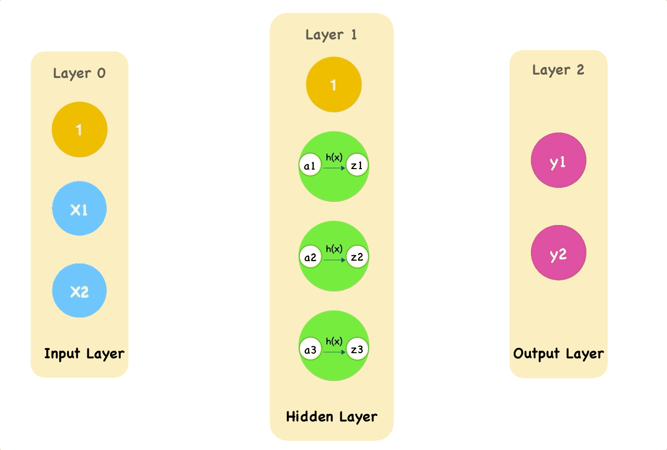
Forward Propagation

Slide 3
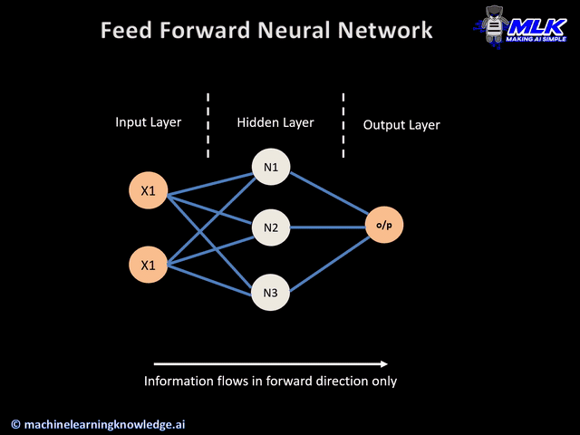
Forward Propagation

Slide 4

Feedback Matters

Slide 5
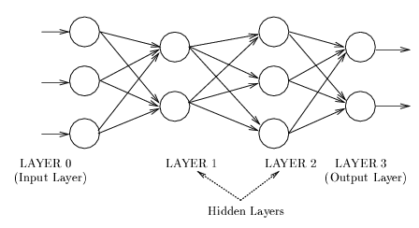
How to get appropriate weight set?
Back-propagation is the famous algorithm for training feed-forward networks

Slide 6
Back-propagation(BP)
Error =
Desired Output - Actual Output
Input
Output
(Input Layer)
(Hidden Layer)
(Output Layer)
Forward Pass: Error is calculated based on desired and actual output.
Backward Pass: Synaptic weights are adjusted based on calculated error.

Slide 7

Back-propagation(BP)

Slide 8

Forward and Background Propagation

Slide 9
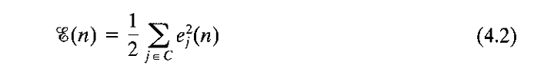
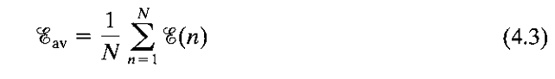
Back-propagation
(Input Layer)
(Hidden Layer)
(Output Layer)

Slide 10
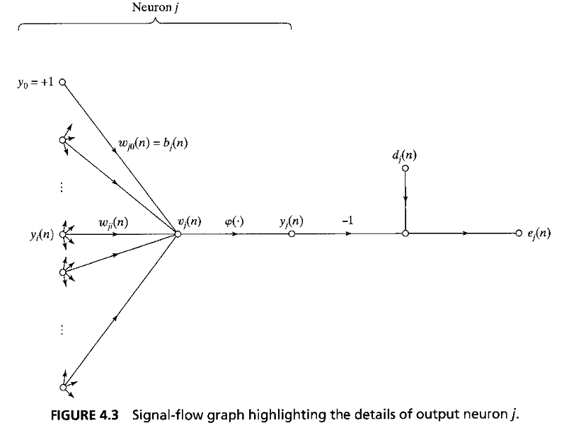
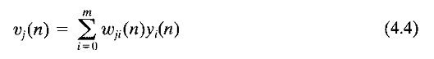
Back-propagation (Without HN)
Forward Pass:
Backward Pass:

Slide 11
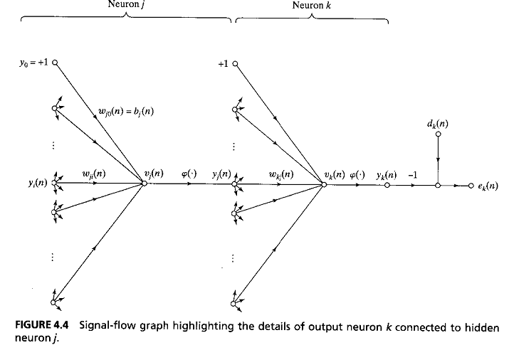
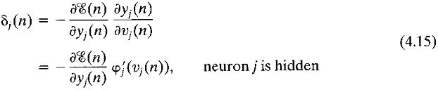
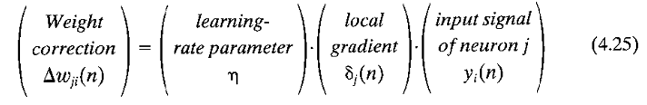
BP for Multilayer (With HN)

Slide 12
BP for Multilayer (With HN)

Slide 13
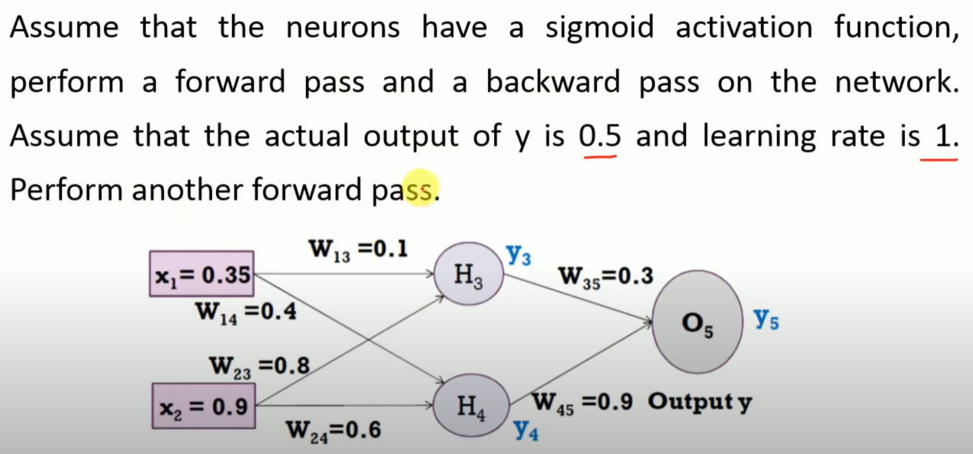
Backpropagation Example

Slide 14
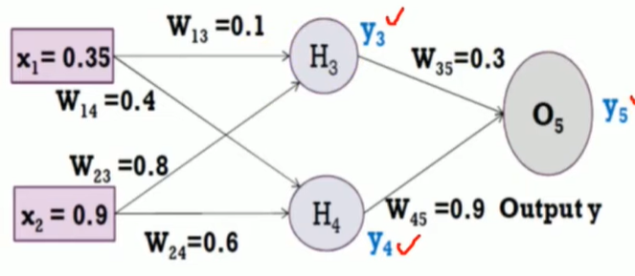
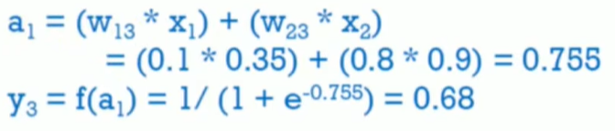
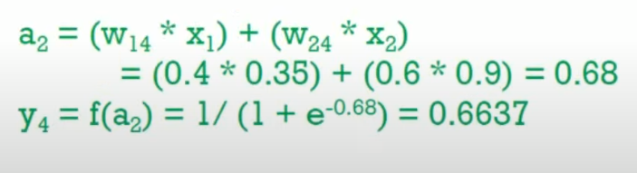

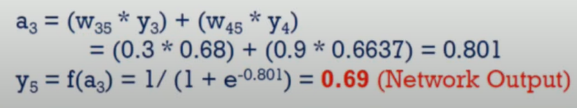
Forward Pass

Slide 15
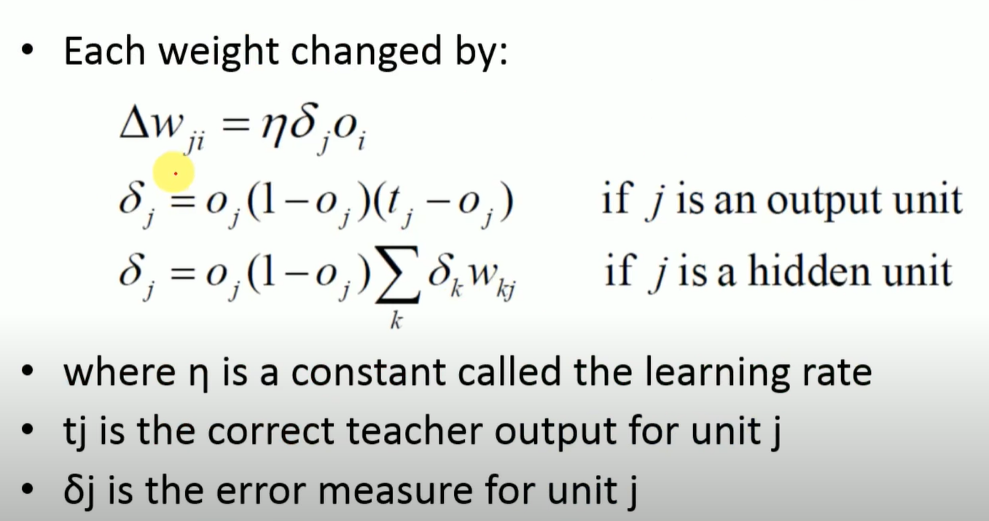
Backpropagation

Slide 16
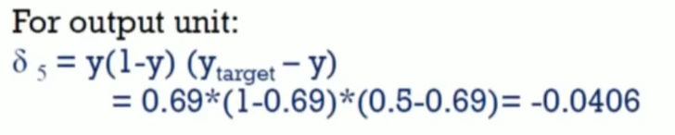
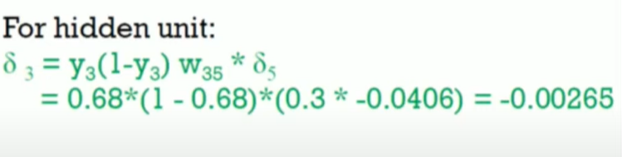
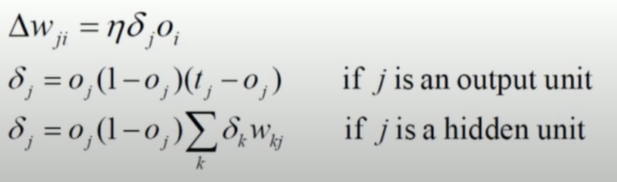
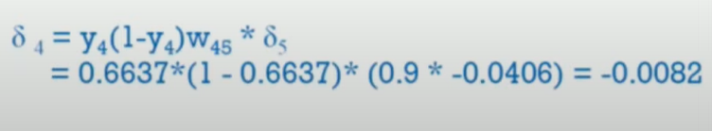
Backpropagation

Slide 17
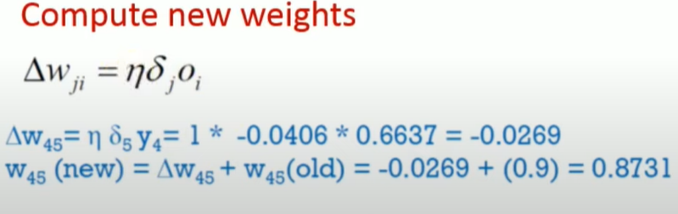
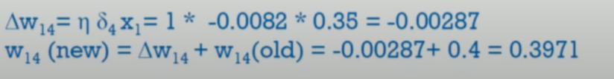
Backpropagation

Slide 18
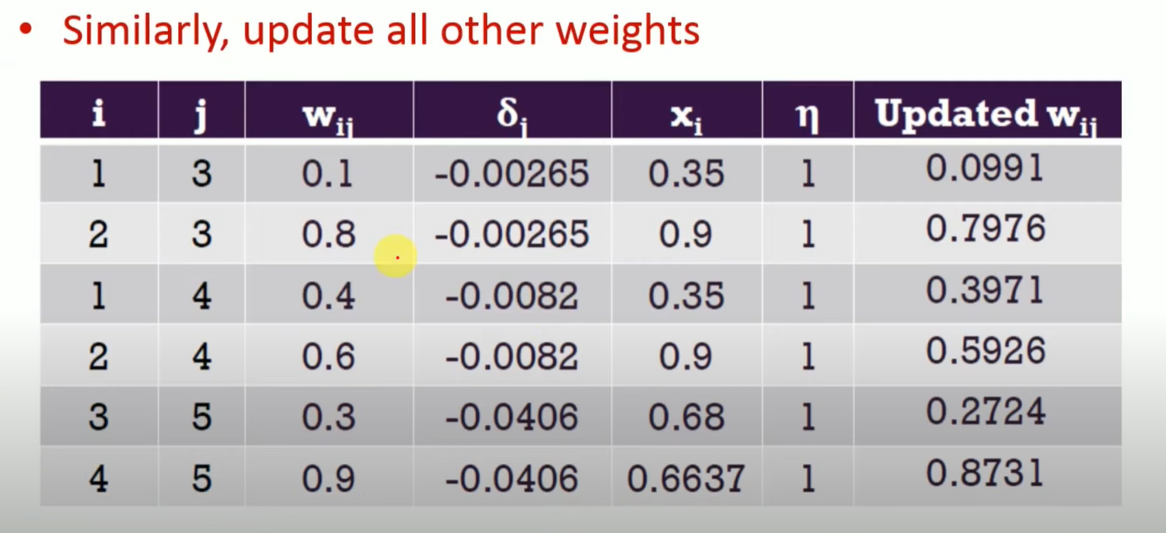
Backpropagation

Slide 19
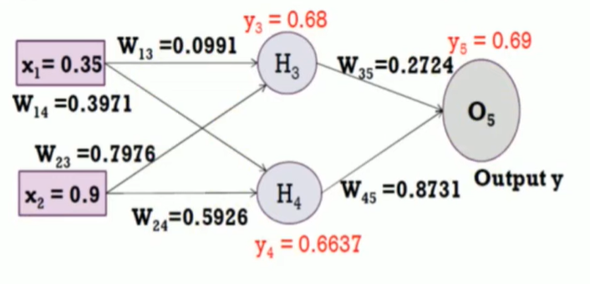
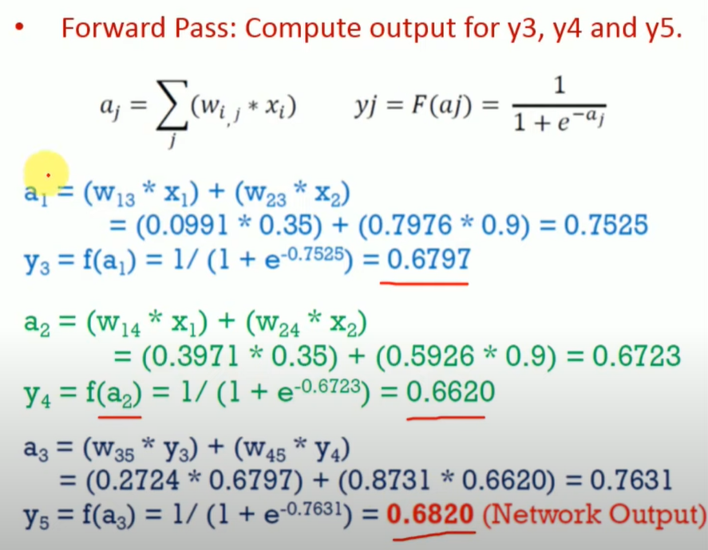
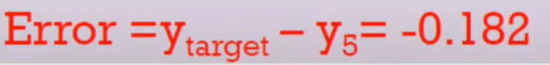
Backpropagation Epoch-2

Slide 20
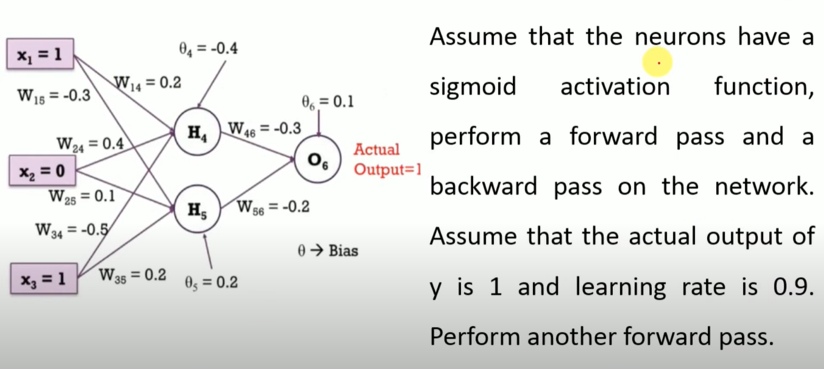
Backpropagation Problem 2

